Slide 1

Faculty of Science & Technology
Jagran School of Computer Application
Major Project Presentation
ORBITUNE – 3D Real-Like Experience
Under the Supervision of:
Mr. Shivangee Nagar
Asst. Prof., Dept. of CSE,
JLU-FAST
Presented by:
Yuvraj Singh Kushwah (2023BCAH062)
Subhro Pal (2023BCAH056)

Slide 2
Outline
Introduction
Importance and Need of Your Project
Contribution & Role of Team Members
Features of your Project
Uniqueness of Project
Tools and Technologies
System/User requirements
Diagrams
Snapshots of the system
Conclusion
Future work

Slide 3
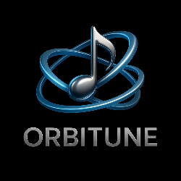
Introduction
ORBITUNE is an AI-powered music platform that delivers 3D spatial audio, mood-based song transformation, and emotion-aware recommendations for an immersive, personalized listening experience.
It bridges the gap between static stereo playback and interactive, adaptive audio by combining stem separation, real-time effects, and chatbot intelligence.
The system runs on a modular stack (React + Web Audio API frontend, FastAPI + Python backend) designed for fast previews and background high-quality renders.
Core focus: immersive sound, instant mood switching (rock/pop/classical/jazz/country), and recommendations that reflect real-time emotional context.

Slide 4
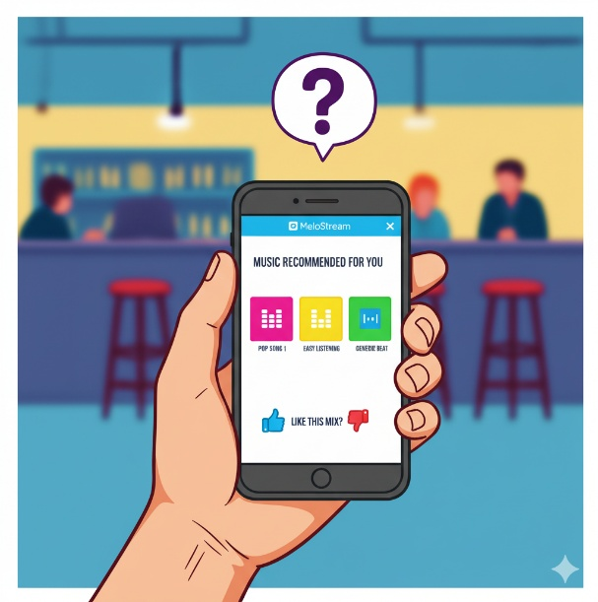
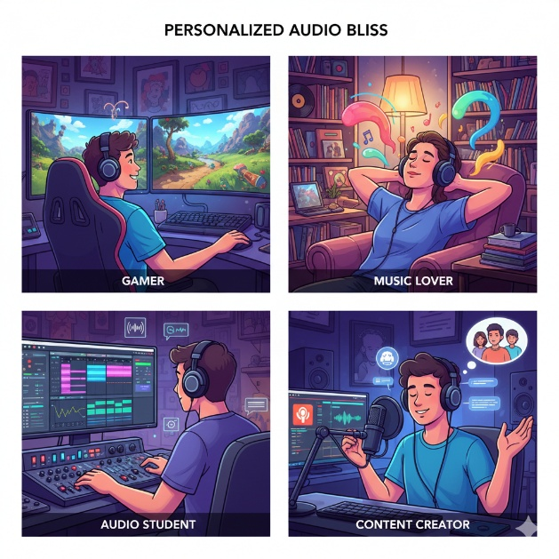
Importance & Need of Your Project
❌ Problems We Solve ✅
Stereo listening feels flat and non-immersive.
ORBITUNE converts tracks to spatial 3D mixes so sound has depth and movement.
High-quality spatial rendering is slow and costly.
Cached derivatives and a queued HQ render pipeline
Songs are fixed to one style.
ORBITUNE does stem-level mood conversion (drum/instrument swaps, EQ, reverb) so a song can sound rock, pop, classical, etc.

Slide 5
Importance & Need of Your Project
❌ Problems We Solve✅
Recommendations ignore current feelings
ORBITUNE’s chatbot (integrated) detects text mood and suggests 3D tracks matched to that emotion.

Slide 6
Contribution & Role of Team Members
YUVRAJ SINGH KUSHWAH
👩‍💻 Team Member 1
Role: Backend & AI Developer
🐍 Python FastAPI
🤖AI/ML
📊 Audio Processing
SUBHRO PAL
👨‍💻 Team Member 2
Role: Frontend Developer
🎨 React UI/UX
🔊 Web Audio API
📱 User Interface
🤝 Shared Responsibilities
Testing & Debugging Documentation Deployment

Slide 7
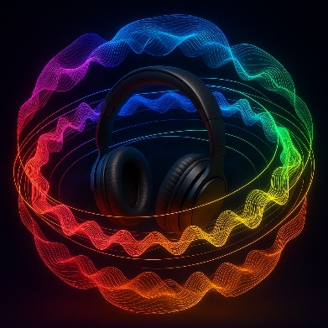
Features of your Project
🌟 Core Features
Immersive 3D sound:
Separates song parts and places each sound in 3D so music feels around your head.
Uses realistic room reverb so distance and space feel natural.
Lets you preview instantly in the browser.
Simple chatbot + Personal Recomendations:
You type how you feel. The chatbot understands and suggests songs that match that mood.
Uses what you already listen to, so suggestions fit your taste.
Gives short, clear reasons for each suggestions. (so that it feels personal)
Keeps your settings and history locally and only stores what you allow.

Slide 8
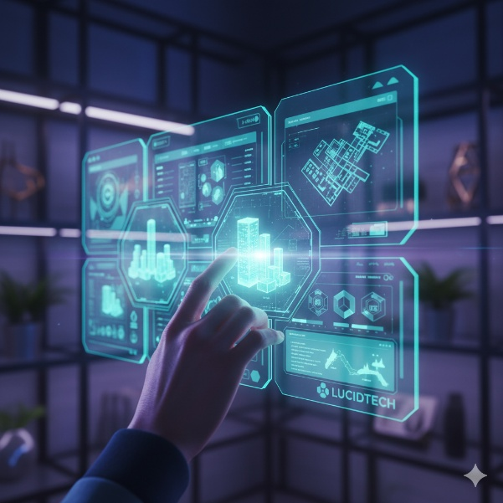
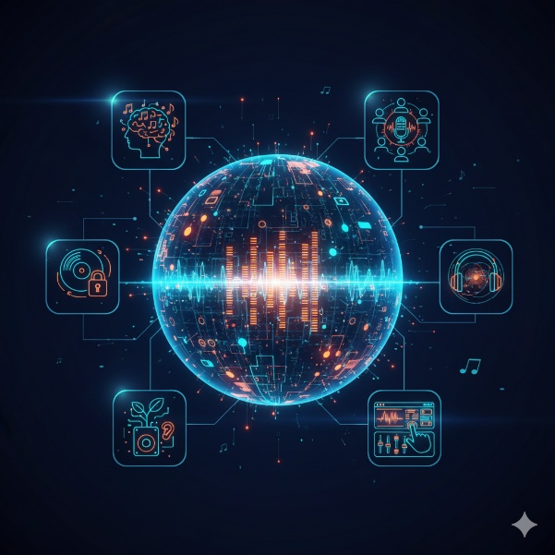
Uniqueness of Project
Three Technologies Combined:
3D Audio
Mood Change
Chat bot (Song recommendations on the basis of understanding current human emotion)
Innovation Points:
3D experience of any song.
Mood-switching on any track
Emotion analysis (through user’s entered story)

Slide 9
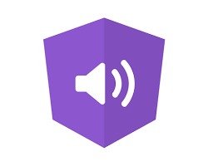
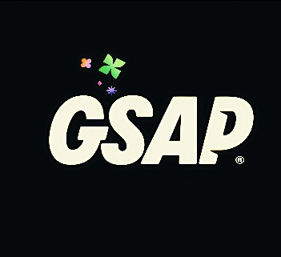



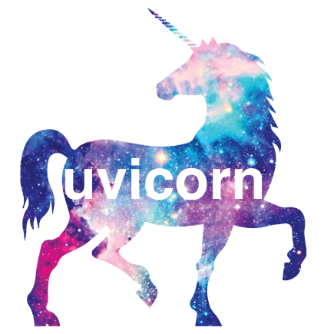






Tools and Technologies
For Frontend :
For Backend:
Audio ML / Tools :
JavaScript
Vite Js
Web Audio Api
GSAP
Python

Slide 10



Tools and Technologies
For Storage:
Dev Tools:
LOCAL FILE SYSTEM
VS CODE

Slide 11
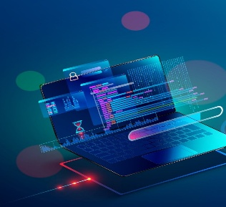

System/User requirements
SYSTEM REQUIREMENTES
Hardware:
RAM: 8GB+ (16GB ideal)
CPU: Multi-core
Storage: 10GB+
Headphones: Required!
Software:
Browser: Chrome/Firefox/Safari
OS: Windows/Mac/Linux
Internet: Stable connection
USER REQUIREMENTES
Quality headphones
Music files (MP3/WAV)
English text input
Basic computer skills

Slide 12
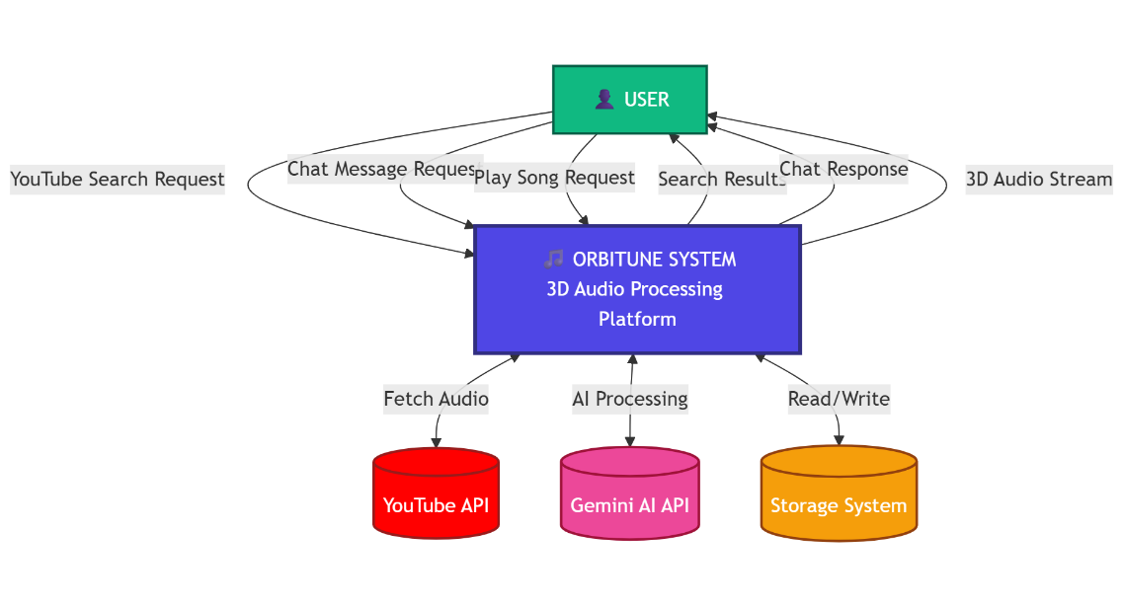
Diagrams
Data Flow Diagram (DFD)
Level 0 DFD – Context Diagram

Slide 13
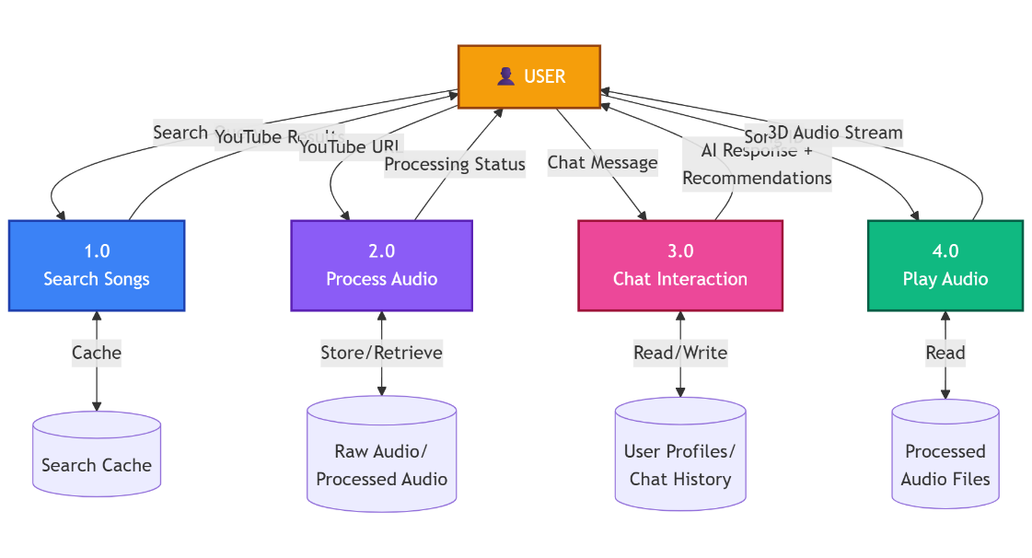
Diagrams
Data Flow Diagram (DFD)
Level 1 DFD – Major Processes

Slide 14
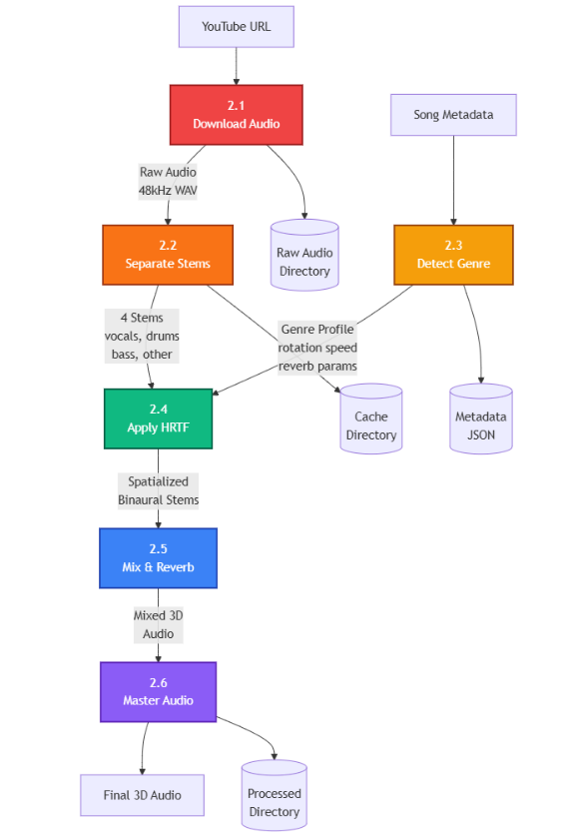
Diagrams
Data Flow Diagram (DFD)
Level 2 DFD – Audio Processing

Slide 15
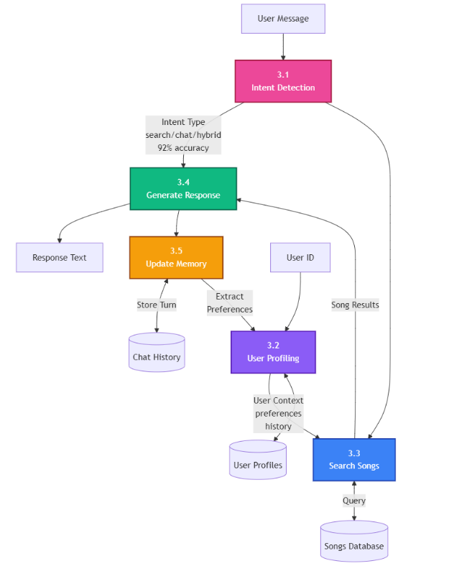
Diagrams
Data Flow Diagram (DFD)
Level 2 DFD – Chatbot System

Slide 16
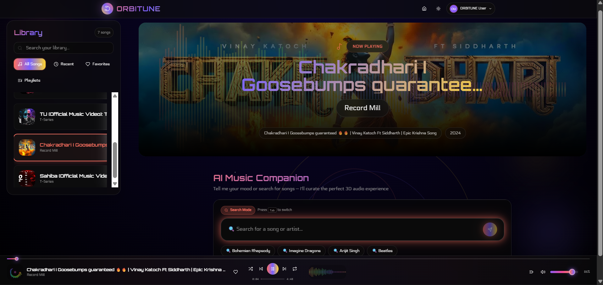
Snapshots of system
The main dashboard of the project

Slide 17
Conclusion
ORBITUNE makes songs more immersive with 3D audio experience.
Users can change the mood of any song (rock, pop, jazz, etc.).
Integrated chatbot suggests music based on user’s emotions.
Simple design with previews, caching, and HQ renders.
Focused on user privacy with local JSON storage.
Suitable as a demo/academic project; can be expanded in future.

Slide 18
Future Work
Personalize spatial audio via HRTF presets and headphone profiles to improve localization.
Expand mood/genre library and enhance tempo/pitch-aware transformations with higher-quality time-stretching.
Add voice-based and multilingual emotion detection alongside current text models.
Release mobile apps (iOS/Android) with on-device previews and cloud offload for heavy renders.
Provide creator toolkit, licensing workflows, and partnerships for royalty-free/cleared catalogs.

Slide 19
References
MDN Web Docs — PannerNode (Web Audio API 3D spatialization): https://developer.mozilla.org/en-US/docs/Web/API/PannerNode
iZotope — Spatial audio, immersive audio, and 3D sound explained: https://www.izotope.com/en/learn/spatial-audio
Demucs vs Spleeter — The Ultimate Guide (stem separation comparison): https://beatstorapon.com/blog/demucs-vs-spleeter-the-ultimate-guide/
IJSREM — BERT-Based Emotion Detection and Real-Time Content Recommendation: https://ijsrem.com/download/bert-based-emotion-detection-and-real-time-content-recommendation-system-for-digital-mental-health-support/
TestDriven.io — Developing a Single Page App with FastAPI and React: https://testdriven.io/blog/fastapi-react/

Slide 20
THANK YOU

